Slide 1




GEMOC modeling crash course
---An introduction to EMF tooling ---
2017
Didier Vojtisek (Inria)
http://people.rennes.inria.fr/Didier.Vojtisek/
Didier.vojtisek@inria.fr
Benoit Combemale (Inria & Univ. Rennes 1)
http://people.irisa.fr/Benoit.Combemale
benoit.combemale@irisa.fr
@bcombemale

Slide 2
Course main purpose
see how EMF+GEMOC technologies helps to (semi-automatically) build the tooling for a DSL IDE

Slide 3
Finite State Machine

Slide 4
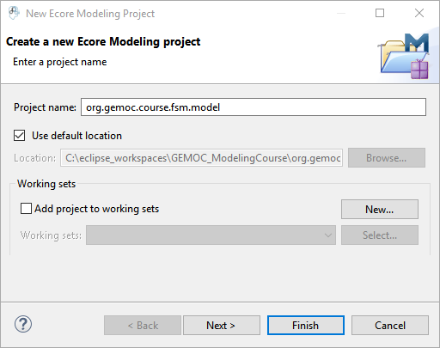
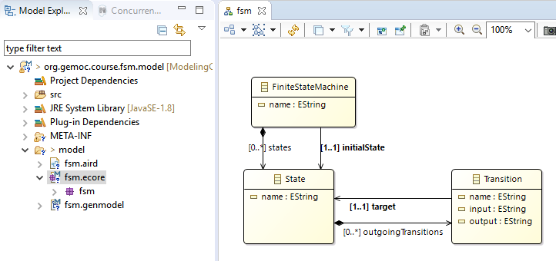
Create the following "ecore modeling project" with these concepts

Slide 5
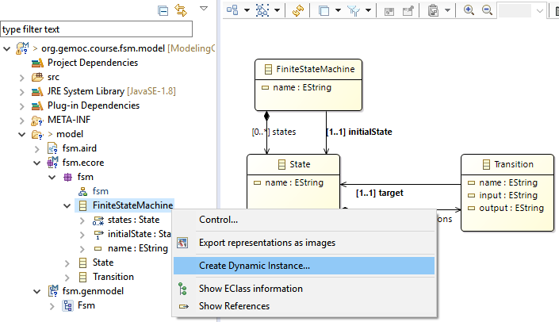
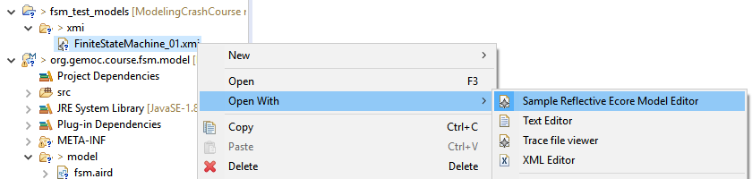
Create a sample model in current workbench
Creates an XMI either in a test folder of your project or in a separate project
Open with the Reflective editor

Slide 6
Create a sample model with non determinism
Ie. With 2 outgoing transition with the same input

Slide 7
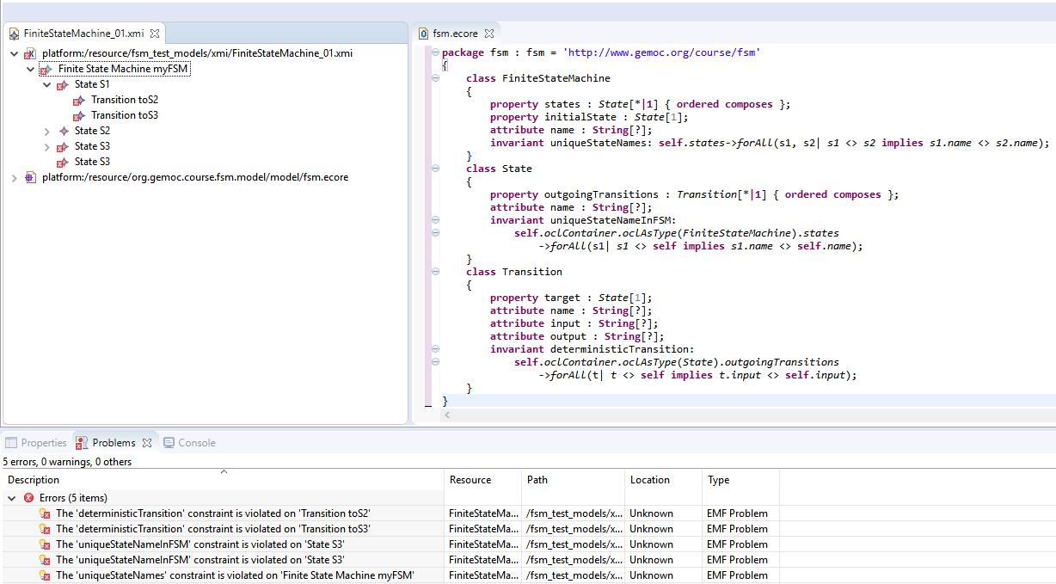
Open fsm.ecore in text editor and add some constraint
OCLInEcore
For example: check name uniqueness
context FiniteStateMachine
invariant uniqueStateNames:
self.states->forAll(s1, s2| s1 <> s2 implies s1.name <> s2.name);

Slide 8
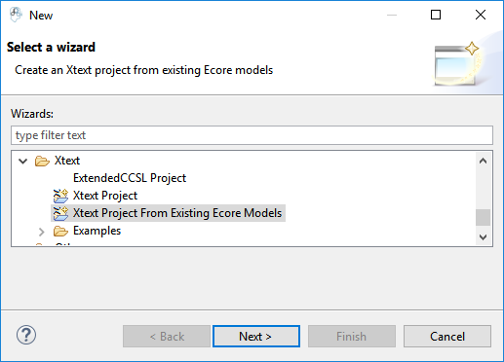
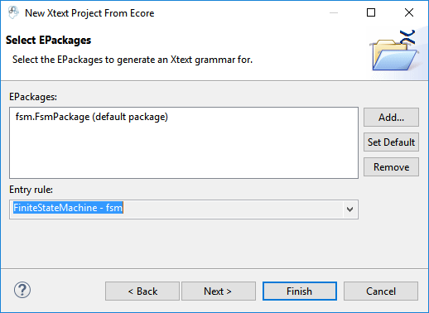
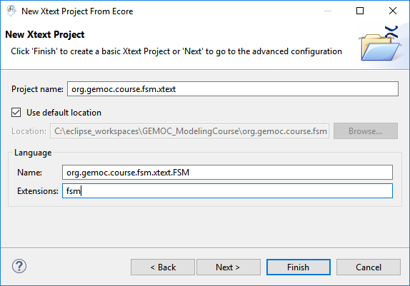
Generate text editor

Slide 9
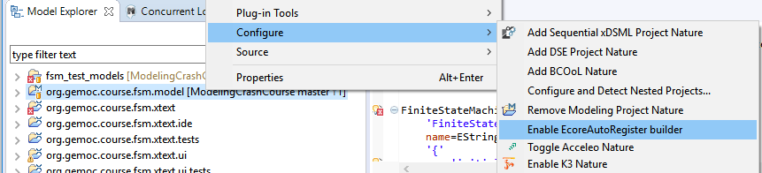
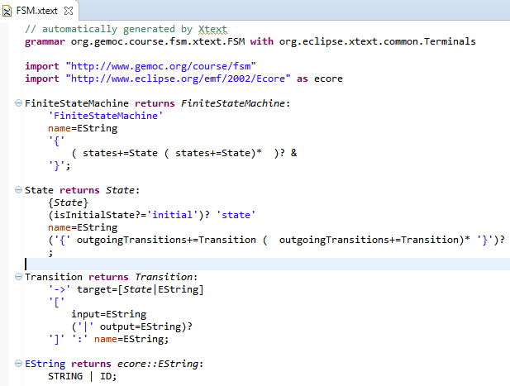
Adapt grammar
Add EcoreAutoRegister to help removing errors

Slide 10
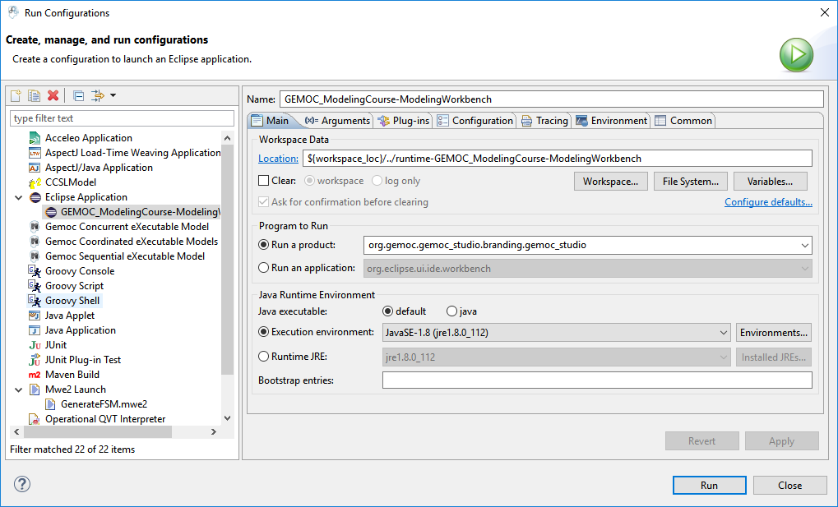
Test in a runtime workbench

Slide 11
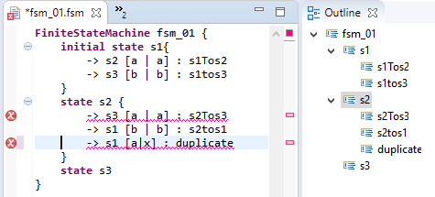
Try the text editor

Slide 12
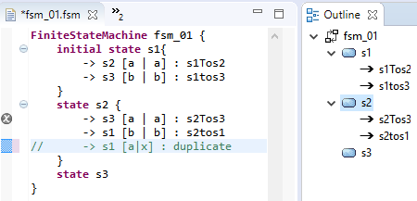
Improve text editor outline
Genmodel : generate edit
Change icons
Adapt labels

Slide 13
Create graphical editor : viewpoint specification

Slide 14
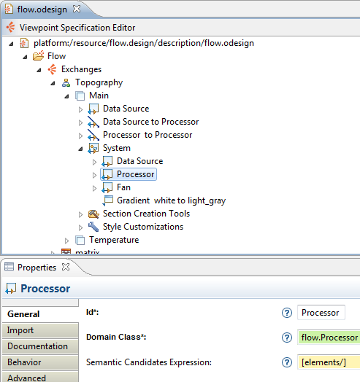
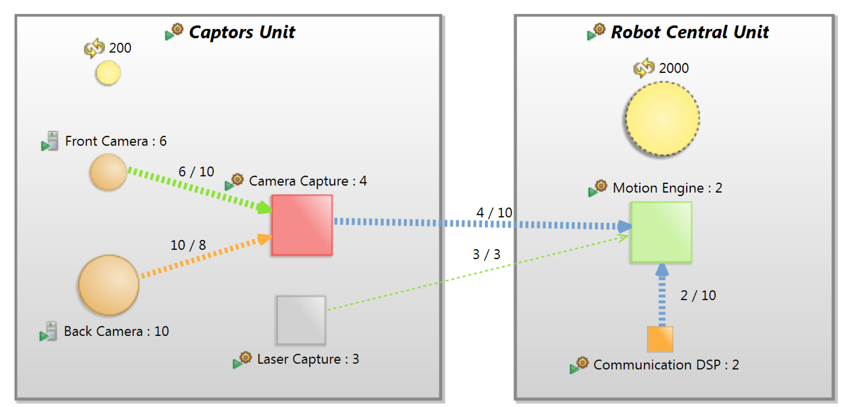
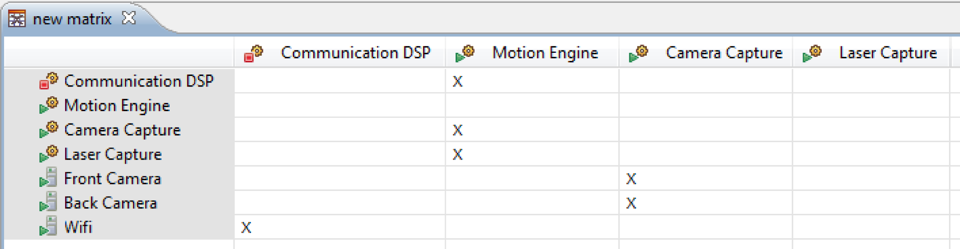
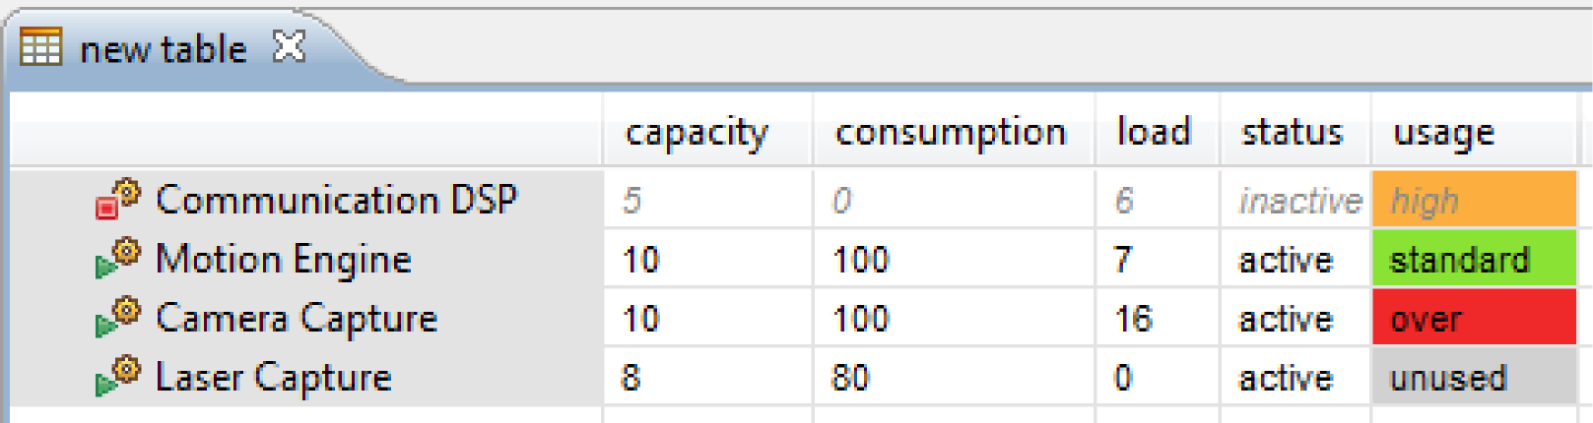
Sirius : Principes
Outilleurs / Développeurs
Utilisateur final
Environnement de spécification
Environment d'exécution (runtime)

Slide 15
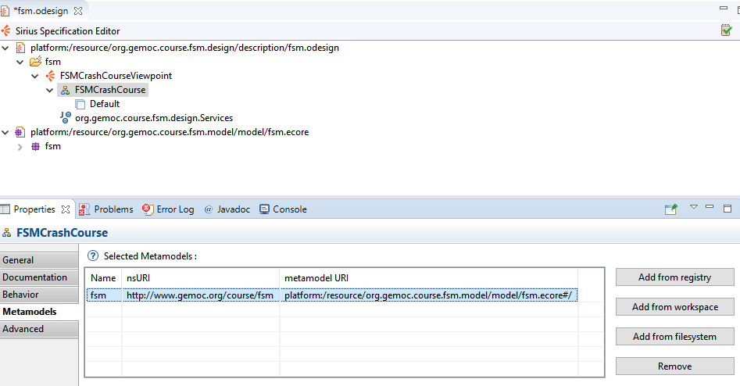

Slide 16
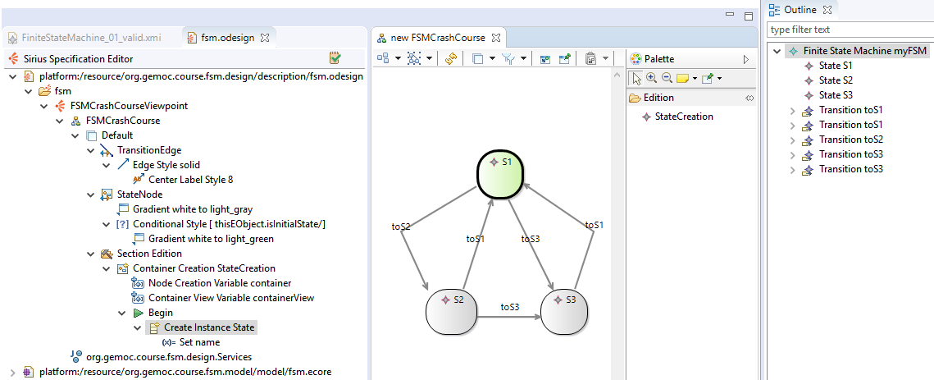
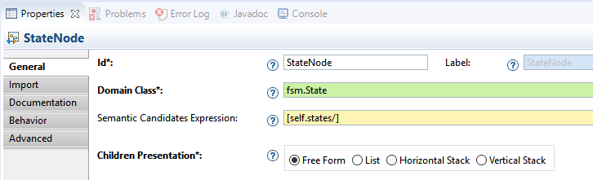
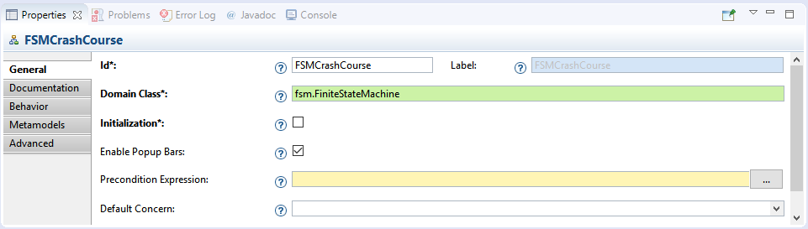
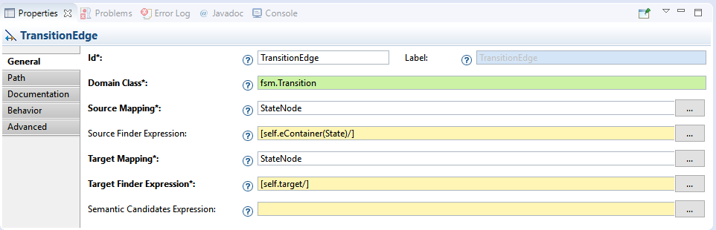
Create viewpoint

Slide 17
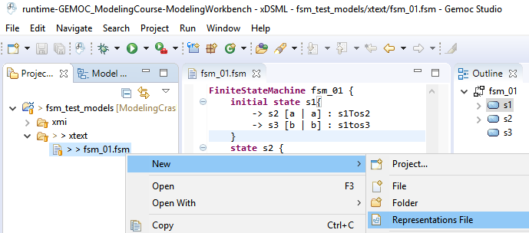
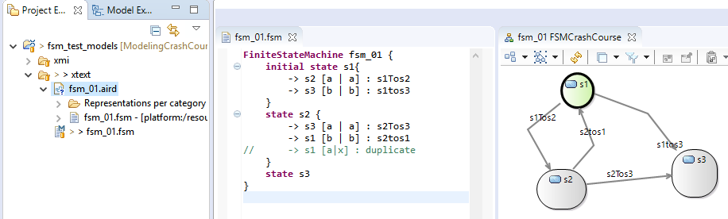
Xtext + Sirius
Model can be edited on both editors

Slide 18
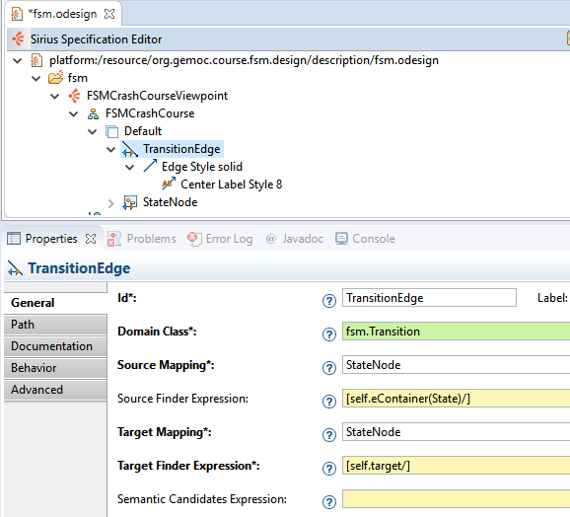
Create graphical editor - steps
Create viewpoint spec project
Create diagram representation
Connect metamodel
Indicate root container
Create Container diagram element
Start a dynamic represention on one of the xmi test models
Connect to State,
Add gradient style
cutomize presentation (rounded corners)
Restrict semantic candidates
Add element based edge

Slide 19
Add conditional style
Create a tool section
add a create container tha will create a StateNode

Slide 20
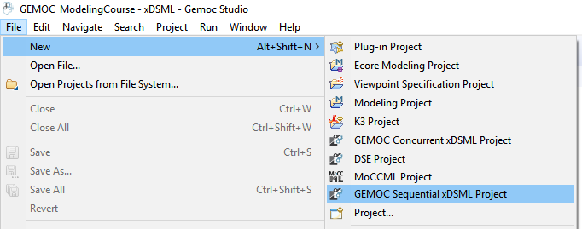
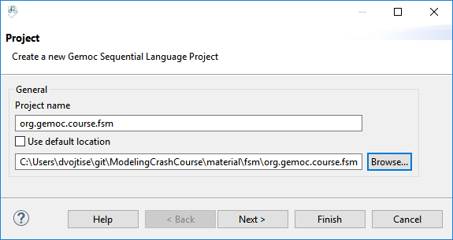
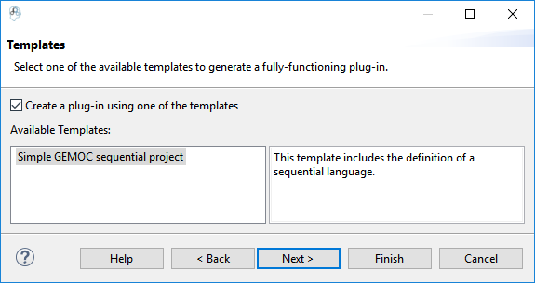
Behavior with Melange and K3

Slide 21
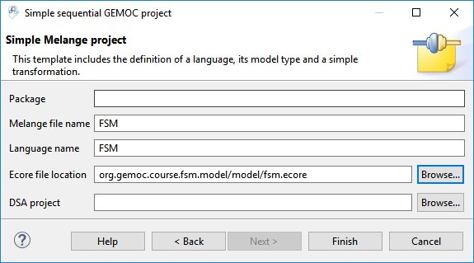
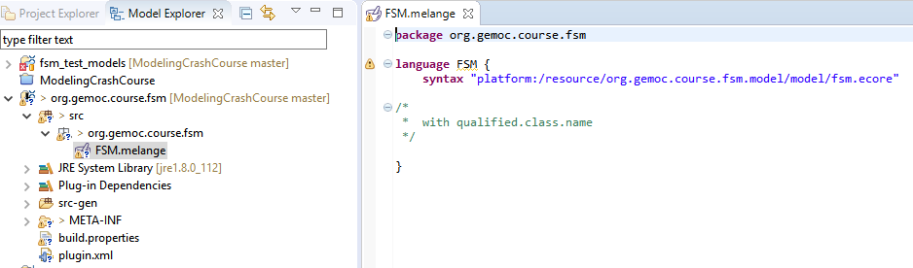

Slide 22
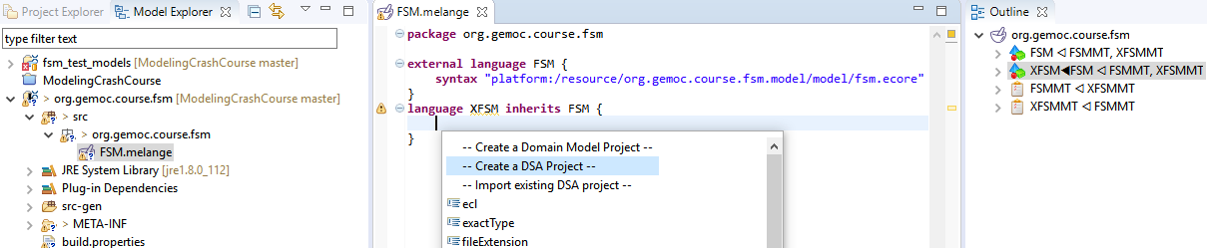
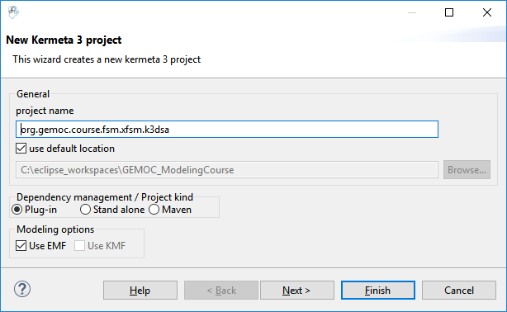
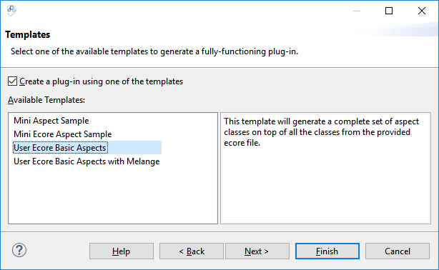

Slide 23
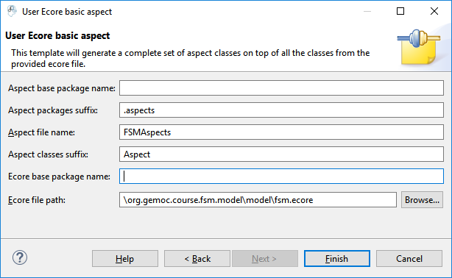
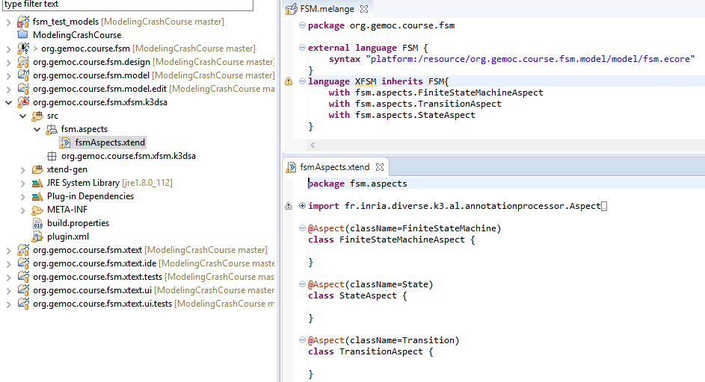

Slide 24
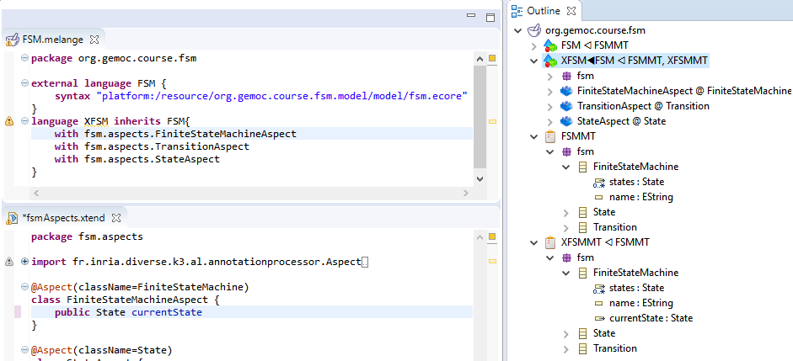
Implement the behavior
New attributes or refrences

Slide 25
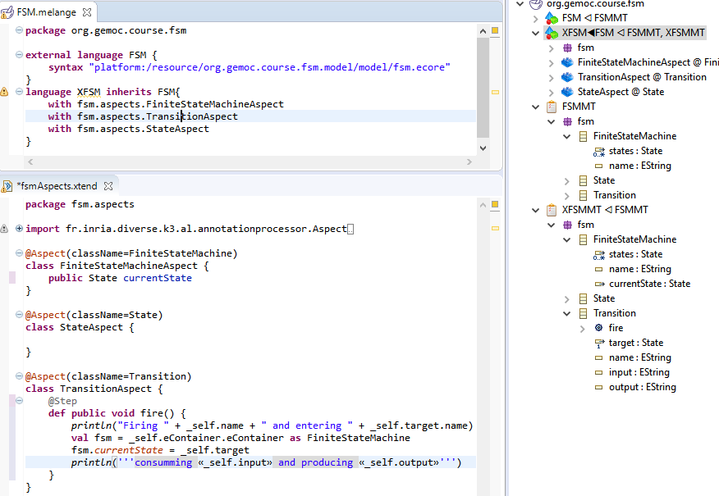
New operations

